Slide 1


ESSAY Question #3 ~ Social (media * e)Commerce
CIS 234E
Electronic Commerce
Website
10967167
hyo05065@berkeley.edu
Email to “DrV”
ProfessorVillegas@gmail.com
Kidong Kim
Page 1
CIS 234E ~ ELECTRONIC COMMERCE WEBSITE * Kidong Kim 415 713 7879

Slide 2
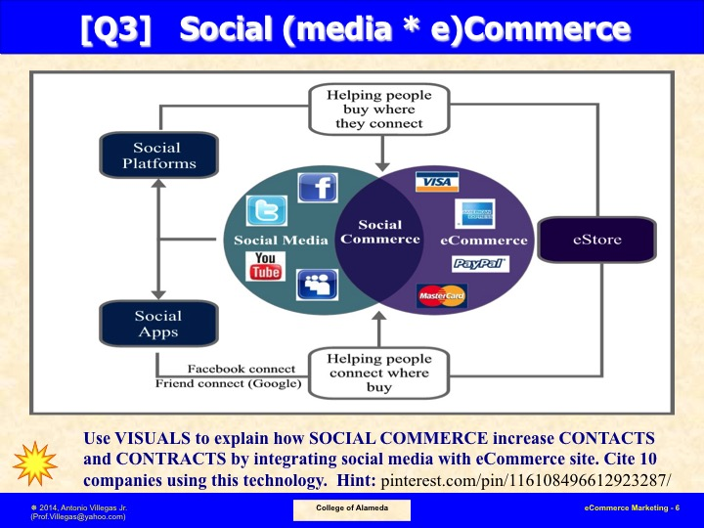
Page 2
CIS 234E ~ ELECTRONIC COMMERCE WEBSITE * Kidong Kim 415 713 7879

Slide 3
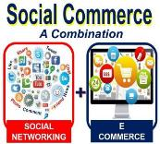
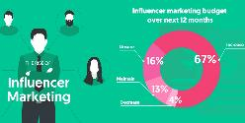
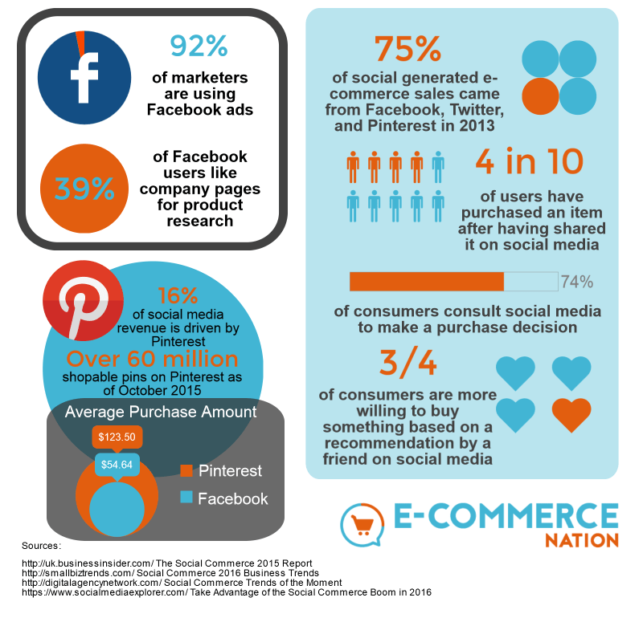
ESSAY Question 3 ~ Social Commerce Defined
What’s Social Commerce?
Social commerce is a
business that combines
Social media and E-commerce
SC Increases Contacts by
Influencer marketing helps
people to see Social business
more frequently and efficiently
SC Increases Contract$ by
By message, Contents, and
Ad in the Social media,
Business can lead customer
to make purchase so can
increase contracts
Place pictures depicting your answers above + short description here
Page 3
CIS 234E ~ ELECTRONIC COMMERCE WEBSITE * Kidong Kim 415 713 7879

Slide 4
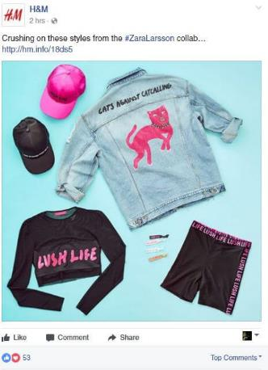
ESSAY Question 3 ~ Social E-Commerce (Example 1)
H&M increases it’s contact and sale by posting the new design of clothes on the Social media
Place a picture depicting your answer above + short description here
Page 4
CIS 234E ~ ELECTRONIC COMMERCE WEBSITE * Kidong Kim 415 713 7879

Slide 5
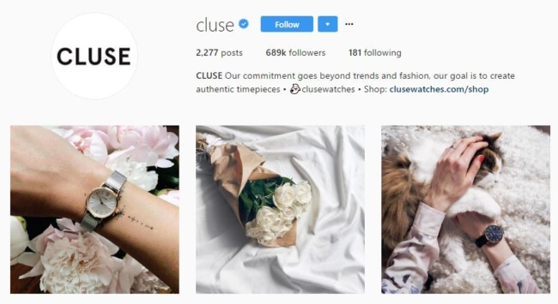
ESSAY Question 3 ~ Social E-Commerce (Example 2)
Cluse uses a social media as their shopping window and a marketing tool
Place a picture depicting your answer above + short description here
Page 5
CIS 234E ~ ELECTRONIC COMMERCE WEBSITE * Kidong Kim 415 713 7879

Slide 6
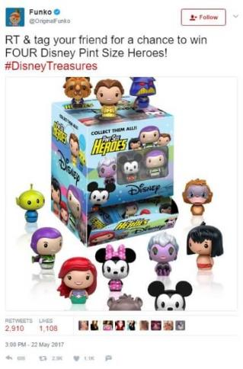
ESSAY Question 3 ~ Social E-Commerce (Example 3)
Funko uses a social media as one of
giveaways channel to communicate
with followers and customers
Place a picture depicting your answer above + short description here
Page 6
CIS 234E ~ ELECTRONIC COMMERCE WEBSITE * Kidong Kim 415 713 7879

Slide 7
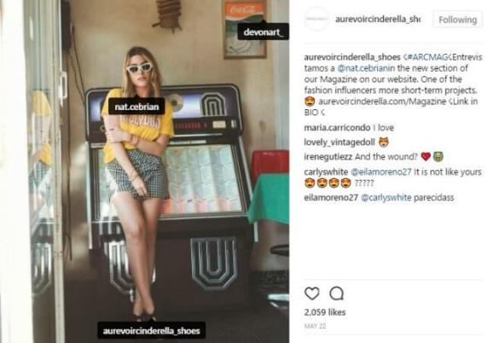
ESSAY Question 3 ~ Social E-Commerce (Example 4)
Au Revoir Cinderella uses the photo
of their customers and followers
to post on the social media to
increase sales and contacts
Place a picture depicting your answer above + short description here
Page 7
CIS 234E ~ ELECTRONIC COMMERCE WEBSITE * Kidong Kim 415 713 7879

Slide 8
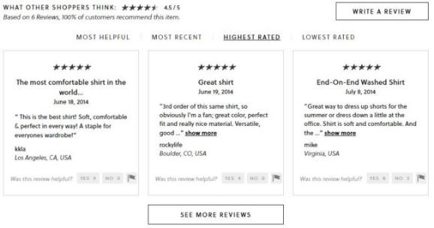
ESSAY Question 3 ~ Social E-Commerce (Example 5)
J crew uses the feedback of their product from their customers and
followers to provide feedback so can provide credit and
attract other customers to buy their items.
Place a picture depicting your answer above + short description here
Page 8
CIS 234E ~ ELECTRONIC COMMERCE WEBSITE * Kidong Kim 415 713 7879

Slide 9
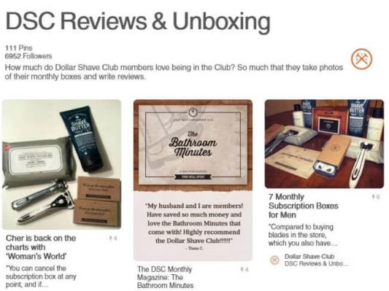
ESSAY Question 3 ~ Social E-Commerce (Example 6)
DSC uses social media as a social
proof by posting unboxing photo
and customer feedback.
Place a picture depicting your answer above + short description here
Page 9
CIS 234E ~ ELECTRONIC COMMERCE WEBSITE * Kidong Kim 415 713 7879

Slide 10
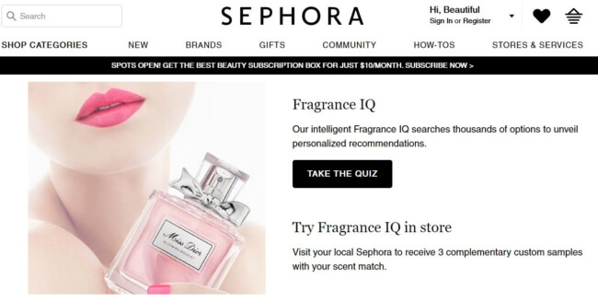
ESSAY Question 3 ~ Social E-Commerce (Example 7)
Unlike other companies, Sephora posts quizzes so
they can recommend the most optimized items by
the result of the quiz to their customers
Place a picture depicting your answer above + short description here
Page 10
CIS 234E ~ ELECTRONIC COMMERCE WEBSITE * Kidong Kim 415 713 7879

Slide 11
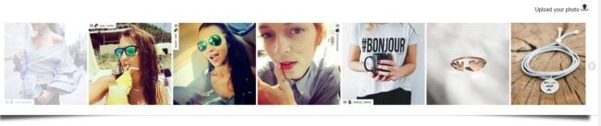
ESSAY Question 3 ~ Social E-Commerce (Example 8)
Singularu creates a look book through social media
so social fans can be engaged to the brand
Place a picture depicting your answer above + short description here
Page 11
CIS 234E ~ ELECTRONIC COMMERCE WEBSITE * Kidong Kim 415 713 7879

Slide 12
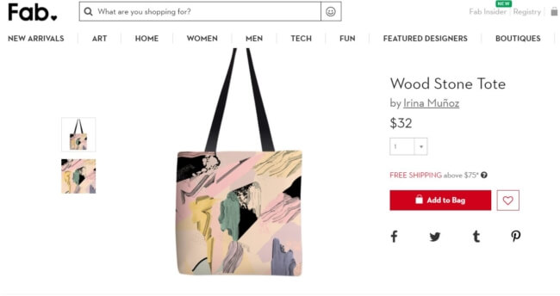
ESSAY Question 3 ~ Social E-Commerce (Example 9)
Fab focused on the feature of conversation of social media
so customer can communicate each other.
By communication among customers, Fab can increase its awareness
Place a picture depicting your answer above + short description here
Page 12
CIS 234E ~ ELECTRONIC COMMERCE WEBSITE * Kidong Kim 415 713 7879

Slide 13
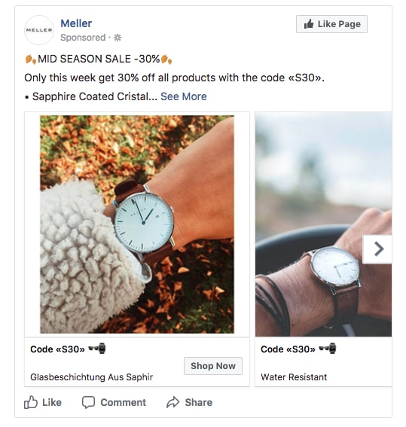
ESSAY Question 3 ~ Social E-Commerce (Example 10)
Meller uses photos of their
customers to post ad on the
Facebook to increase their
conversion rate.
Place a picture depicting your answer above + short description here
Page 13
CIS 234E ~ ELECTRONIC COMMERCE WEBSITE * Kidong Kim 415 713 7879

Slide 14

ESSAY Question 3 ~ Summary of your Answers
By using Social media as marketing channel and a tool,
Social commerce can derive more contracts and contacts.
Communication, Promotion, Feedback Systems and other features of social media
including influencer are what have made the Social commerce so powerful.
Summarize your answers with picture above + short description here
Page 14
CIS 234E ~ ELECTRONIC COMMERCE WEBSITE * Kidong Kim 415 713 7879

Slide 15
ESSAY Question 3 ~ Bibliographical References
1. "Social Commerce: 16 Awesome Examples Of Social Selling". Photoslurp, 2019, https://hi.photoslurp.com/blog/social-commerce-examples/. Accessed 16 May 2019.
2. B-Somrah. "S Commerce". Slideshare.Net, 2019, https://www.slideshare.net/vbsomrah/s-commerce-10371995.
3. Williams, Alicia. "Social Commerce Trends: How To Get Sales With Social Media". Aliste Marketing, 2019, https://alistemarketing.com/blog/social-commerce-trends/.
4. Jaylo, Sian. "Top 7 Trends In Social Media For Marketing Agencies In 2019 - Drumup Blog". Drumup Blog, 2019, https://blog.drumup.io/blog/top-7-trends-in-social-media-for-marketing-agencies-in-2019/.
5. "Social Commerce – The Shift To Social Media Shopping – Diamond Dilemma". Diamond-Dilemma.Com, 2019, http://www.diamond-dilemma.com/social-commerce-the-shift-to-social-media-shopping/.
Page 15
CIS 234E ~ ELECTRONIC COMMERCE WEBSITE * Kidong Kim 415 713 7879

